Slide 1

Introduction to WEB Testing
Eyad Mohamed Afifi Hussain Al-Hussaini Heba Naser
Information Technology Institute
Track Of Software Testing and Quality Assurance

Slide 2

Agenda:-
What is Test Automation?
Why should learn Test Automation?
Why Test Automation?
Manual Testing vs Automation Testing.
Expectations and Myths.
Test Automation Challenges.
Test Automation process.
Types of Automation Testing.
Most popular Test Automation Tools and frameworks.
Selenium WebDriver using java.
TestNG Tool.

Slide 3

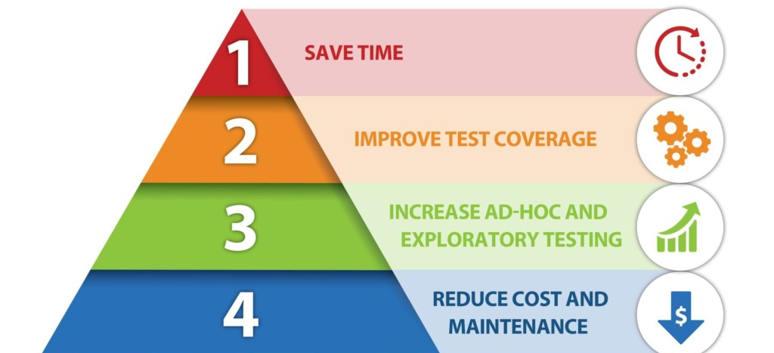
What is Test Automation?
Test automation is the practice of running tests automatically, managing test data, and utilizing results to improve software quality.

Slide 4

Why should learn Test Automation?
Competitive Advantage for Tester.
Reduce time, money and effort.

Slide 5





Why Test Automation?
Reduce time, money and effort.
Reduce redundant work.
Maintain quality (CI).
It is not a trend.

Slide 6
Manual Testing vs Automation Testing
Parameter | Automation Testing | Manual Testing
Definition | Automation Testing uses automation tools to execute test cases. | Automation Testing uses automation tools to execute test cases.
Processing time | Automated testing is significantly faster than a manual approach. | Manual Testing is time-consuming and takes up human resources.
Reliability | Automated Testing is a reliable method, as it is performed by tools and scripts. There is no testing fatigue. | Manual Testing is not accurate because of the Possibility of the human errors.
Programming Knowledge | Programming Knowledge is a must in automation testing. | No need for programming in Manual Testing.
When to use? | Automation Testing is suited for Regression Testing, Performance testing, Load testing or highly repeatable functional test cases. | Suitable for Exploratory testing, Usability and Adhoc testing.

Slide 7

Expectations and Myths.

Slide 8
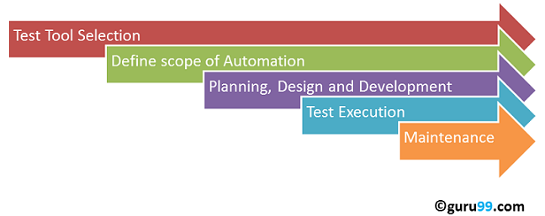
Test Automation process.

Slide 9
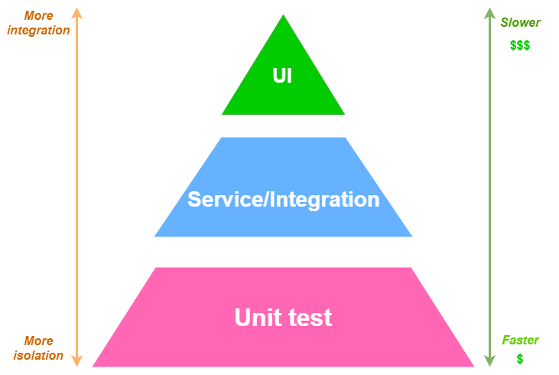
Types of Test Automation

Slide 10
Most popular Test Automation Tools and frameworks
HP-UFT (Web, Mobile, Desktop)
Selenium WebDriver (Web)
Appium (Mobile)
Espresso (Mobile Android)

Slide 11
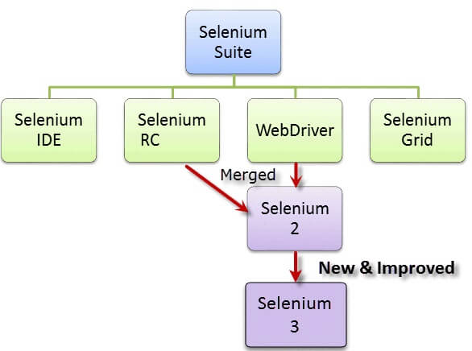
Selenium WebDriver
What is Selenium ?
Selenium is a free automated testing framework used to validate Web applications across different browsers and platforms.
Selenium Software is not just a single tool but a suite of software, each piece catering to different Selenium QA testing needs of an organization.

Slide 12
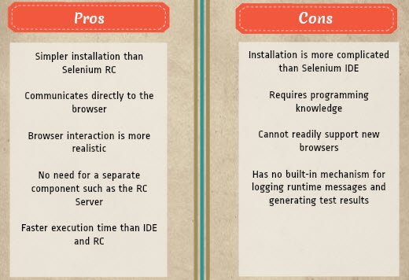
Pros and Cons of Selenium

Slide 13
TestNG Tool
TestNG is a testing framework inspired from JUnit and NUnit but introducing some new functionalities that make it more powerful and easier to use.
TestNG is an open-source automated testing framework; where NG means Next Generation.
TestNG gives the developer the ability to write more flexible and powerful tests. As it heavily borrows from Java Annotations to define tests, it can also show you how to use this new feature of the Java language in a real production environment.

Slide 14
Eclipse vs IntelliJ and why did we choose it
Parameter | Eclipse | IntelliJ
Developer | IBM (original author),Eclipse Foundation | JetBrains
Programming languages supported | Ada, ABAP, C, C++, C#, Clojure, COBOL, D, Erlang, Fortran, Groovy, Haskell, JS, Perl, PHP, Prolog, Python, R, and Scheme. | Dart, Groovy, JSON, HTML, Java, Kotlin, Scala, Python, Rust, XML, XPath, XSL,CSS, Go, JS, PHP, Ruby, SQL,
Intended for | Development in Java and other non-JVM programming languages like C, C++, JavaScript, Julia, Perl, and Haskell. | Development in Java and other JVM programming languages like Groovy and Kotlin.
Recommended for | Advanced programmers and complex projects | Beginners and existing projects
Written in | C and Java | Java and Kotlin

Slide 15
Junit vs TestNG and why did we choose it
Points | JUnit | TestNG
Open-Source | JUnit is an open-source framework used to trigger and write tests. | TestNG is a Java-based framework that is an upgraded option for running tests.
Parallel test Runs | JUnit does not support to run parallel tests. | TestNG can run parallel tests.
Supports Annotation | It does not support advanced annotation. | It supports advanced annotation.
Dependency tests | The dependency tests are missing in JUnit. | Dependency tests are present in TestNG.
Grouping tests | Grouping tests together is not possible in JUnit. | Tests can be grouped together and run parallel.
Ease of Use | Running tests need a certain dependency on JUnit. | Writing tests and configuring them is easy in TestNG than JUnit.

Slide 16
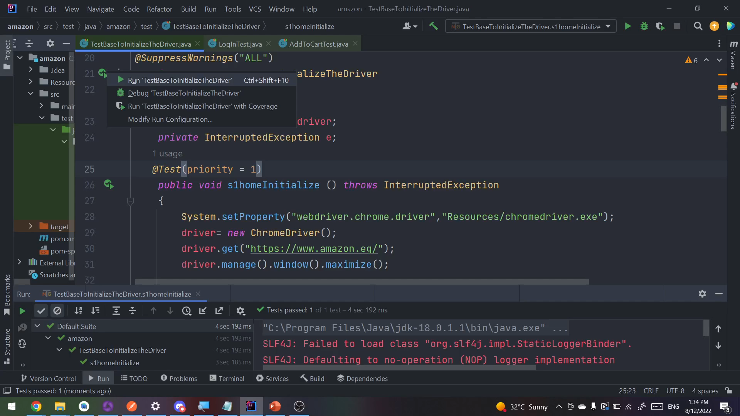
Test Cases:-
1-Change Language Script.

Slide 17
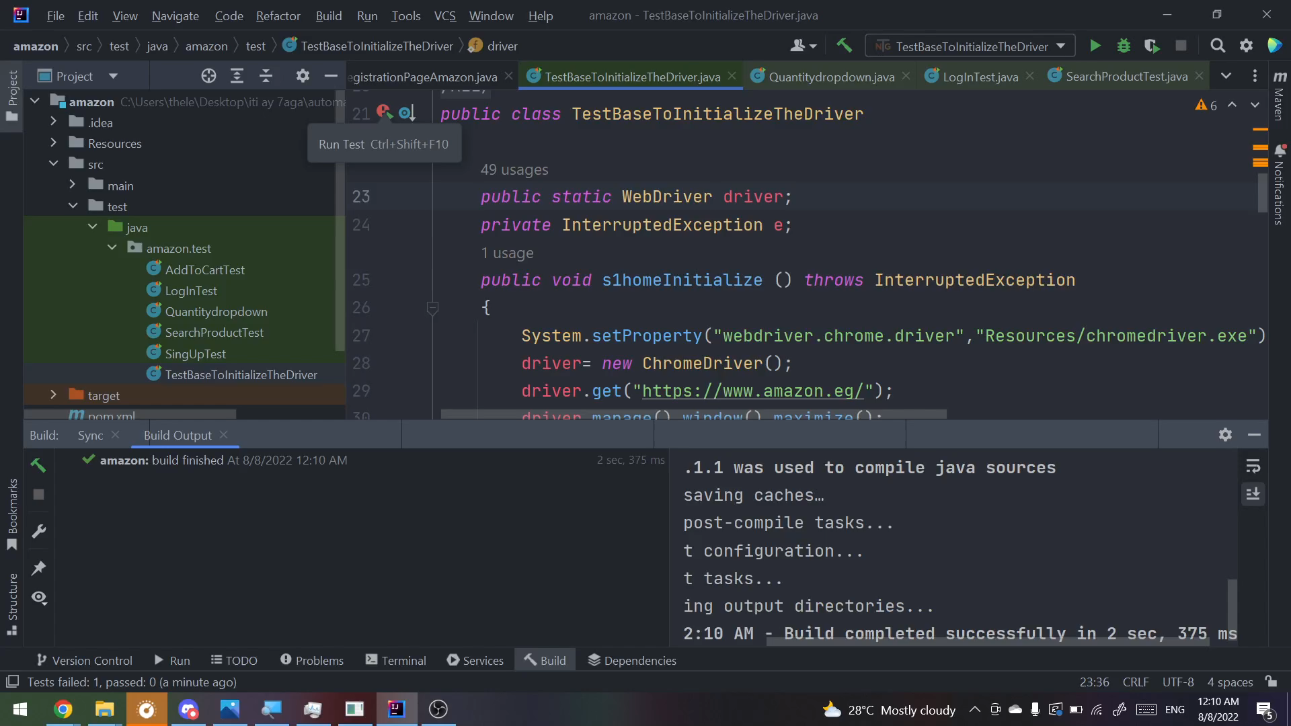
2-Change Location Script.

Slide 18
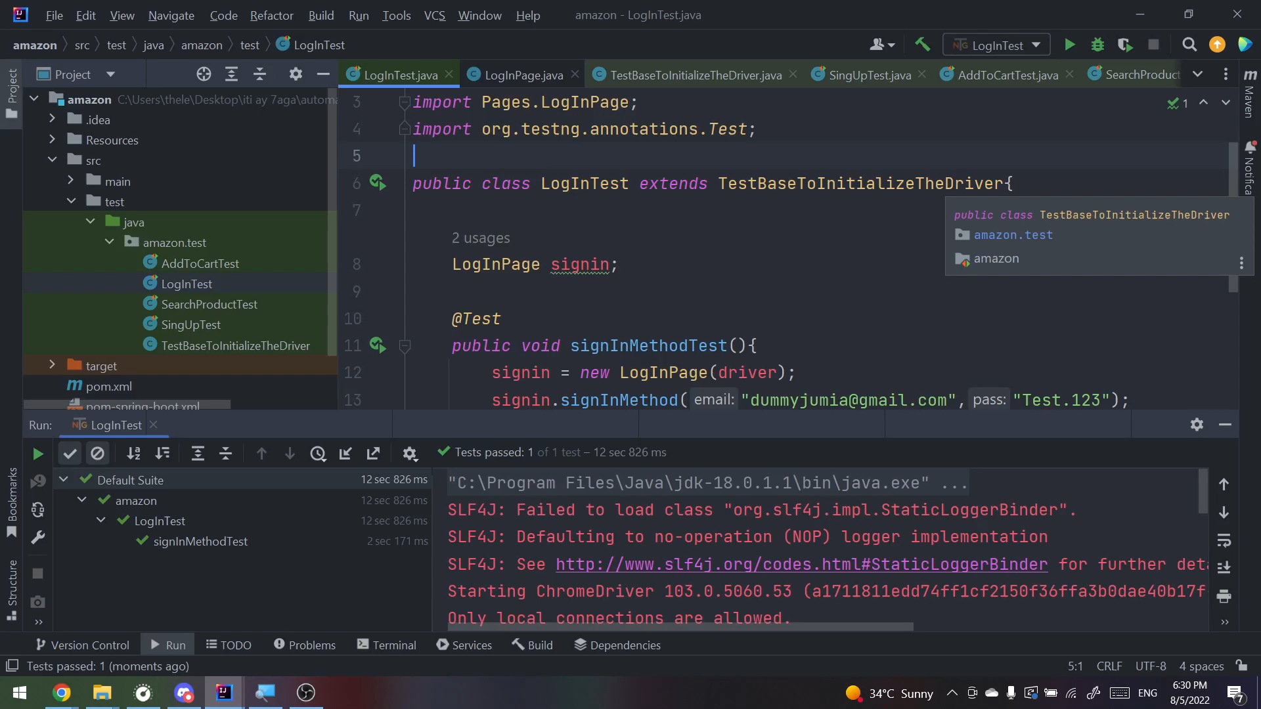
3-Sign In Script.

Slide 19
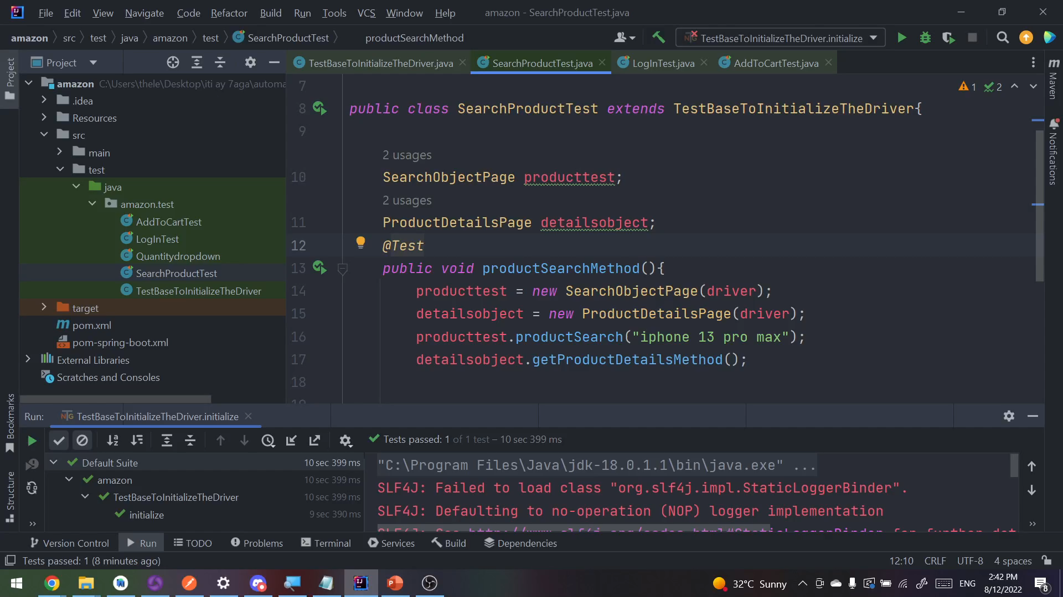
4-Search & Filter.

Slide 20
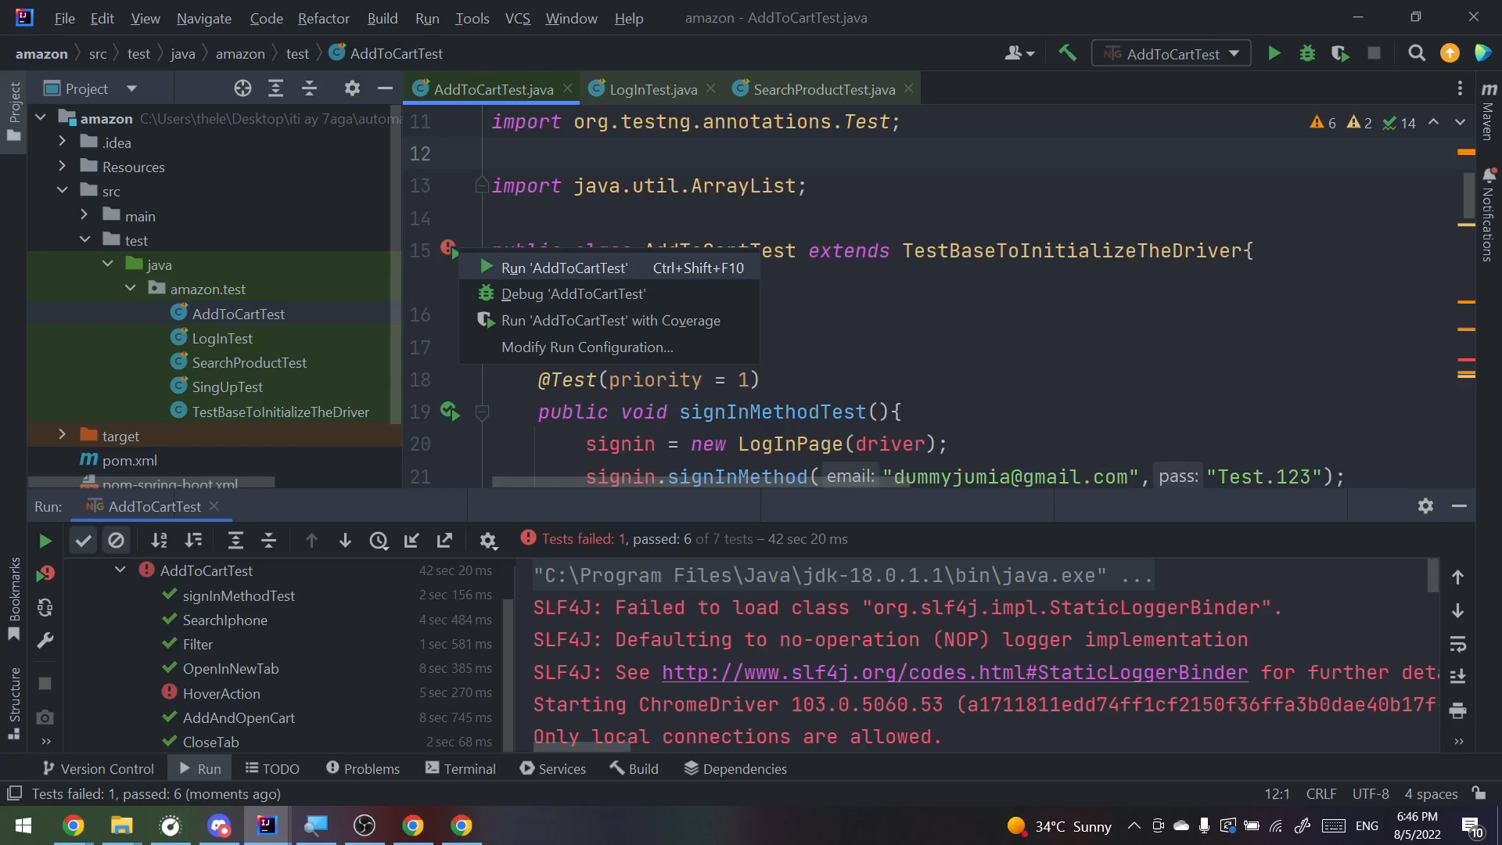
5-Inspecting a product and adding to Cart.(full run)

Slide 21
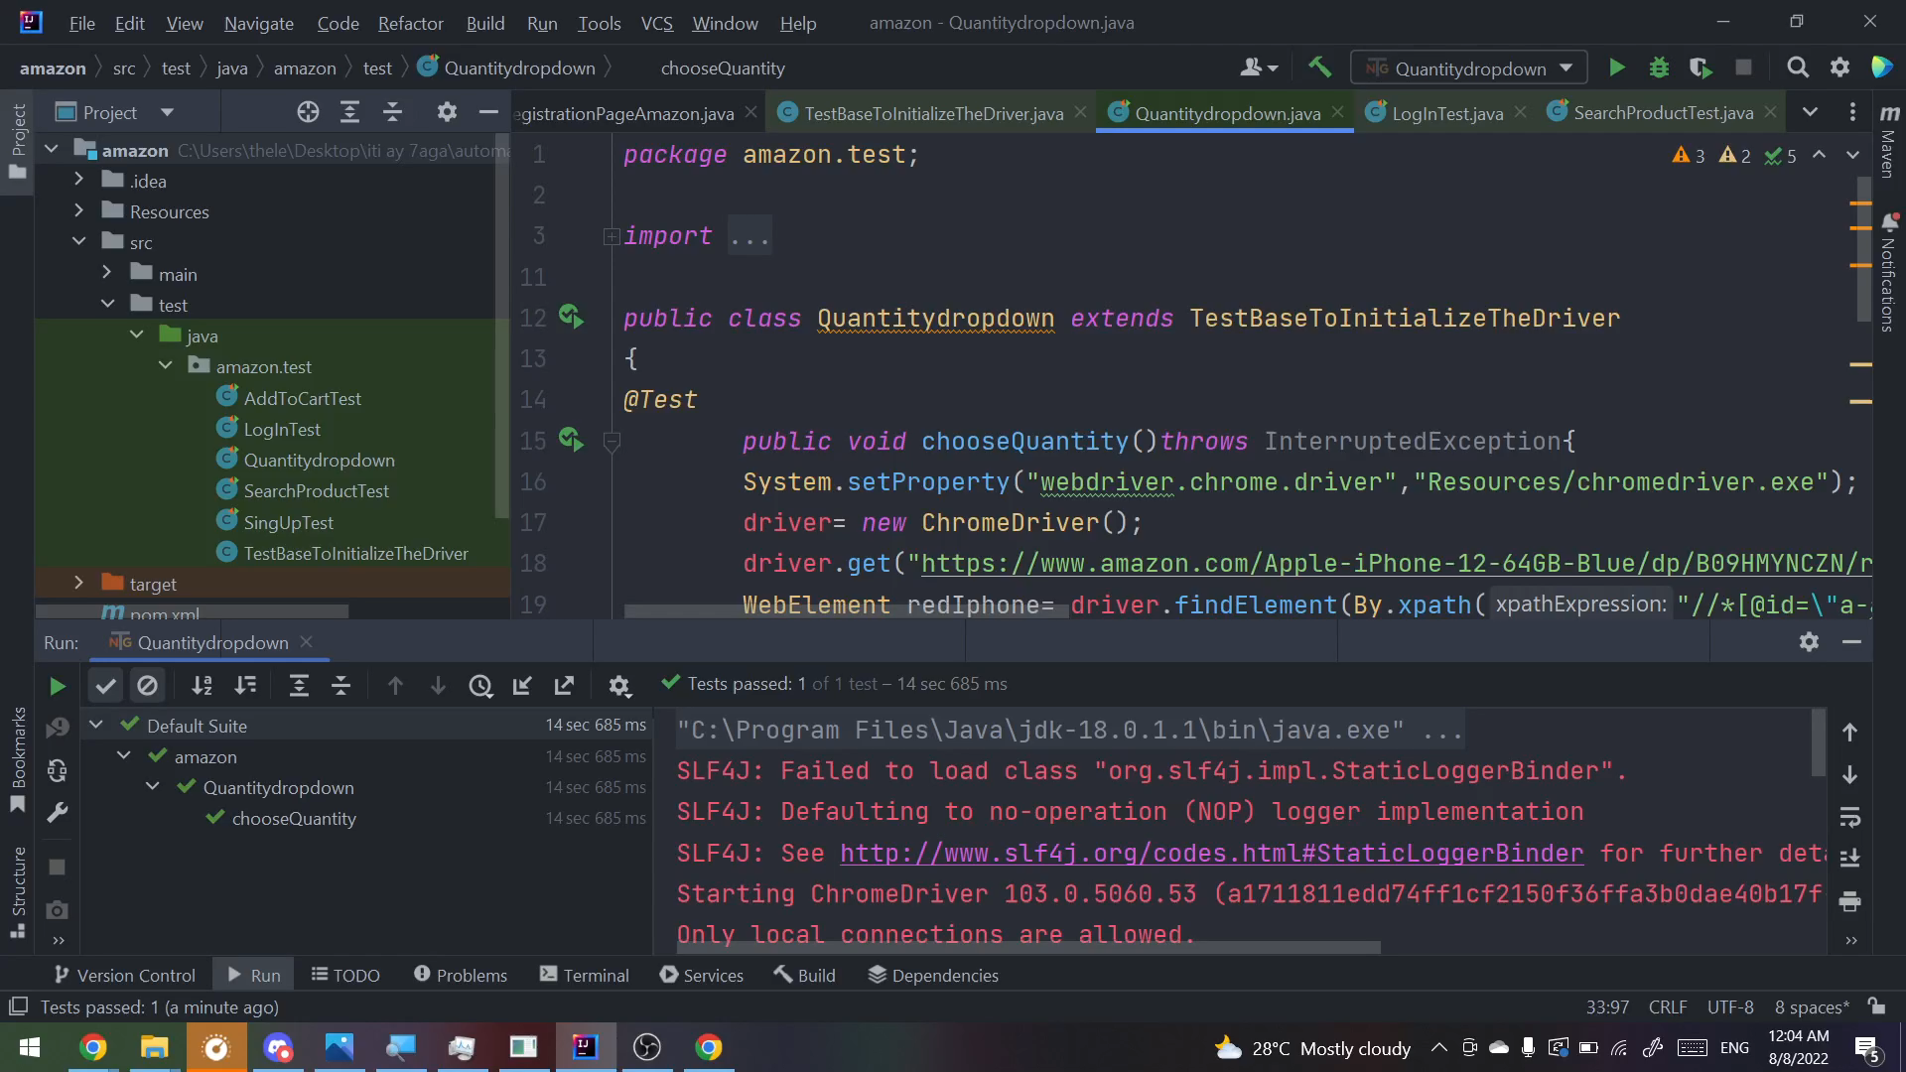
6-Choosing quantity from a drop-down list.

